Slide 1

Dhirubhai Ambani Institute of Information and Communication Technology
EC(IT618) & DSS(IT619) Project Presentation

Slide 2
Project: Homestate (Online Rental Portal)
Group No: 22
Submitted By:
Group Leader : Mahima Gajiwala (201812062)
Team Members : Yash Mehta (201812085)
Vivek Makwana (201812089)
Soniya Vaidya (201812113)
Denish Maniya (201812118)
(All diagrams have been put in design document in case not properly visible in the ppt)

Slide 3
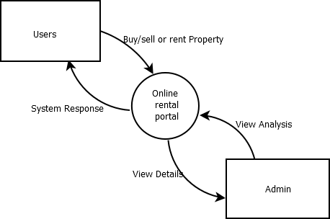
Context Diagram:

Slide 4
Functional Summary (User Stories):
User story No | User Story | Acceptance criteria
US1001 | As a user: want to login into the system with username and password so that sell/rent, buy properties | System must have valid username and password In case s/he is not registered, provide sign up feature
US1002 | As a user: want to add property for selling or renting | user must be logged in before adding property property is added
US1003 | As a user: want to request for a property | user must be logged in before requesting for a property property must have been displayed on the browser property owner must have an valid Email ID in order to receive an email owner will receive an email including the information about buyer
US1004 | As a user: want to delete property added for sell/rent | user must be logged in before deleting property property must have been added before deleting property is deleted from user’s account
US1005 | As a user: want to search properties | user must be logged in before searching properties system must have properties added properties are displayed

Slide 5
User story No | User Story | Acceptance criteria
US1006 | As a user: want to give feedback on property | user must be logged in before giving feedback on property system must have properties added feedback is displayed
US1007 | As a user: want to report a user | user must be logged in before reporting user must choose the valid reasons Necessary action is taken by system administrative
US1008 | As an admin: want to login into the system | System must have valid username and password admin is logged into the system
US1009 | As an admin: want to view analysis of the system | admin must be logged in system should have valid data
US1010 | As an admin: want to add sub-admin for the system | admin must be logged in sub admin is added
US1011 | As an admin: want to block reported user | admin must be logged in check user is reported for valid reasons reported user is blocked

Slide 6
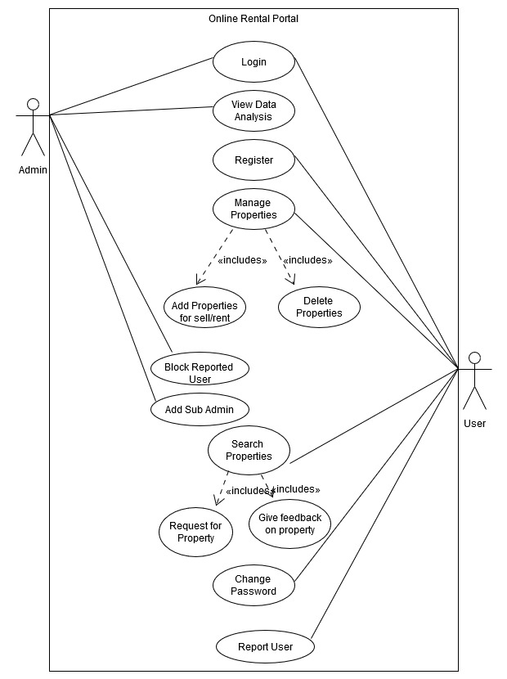
Top Level Use Case Model:

Slide 7
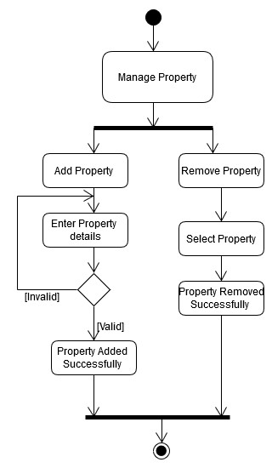
Activity Diagram: Manage Property

Slide 8
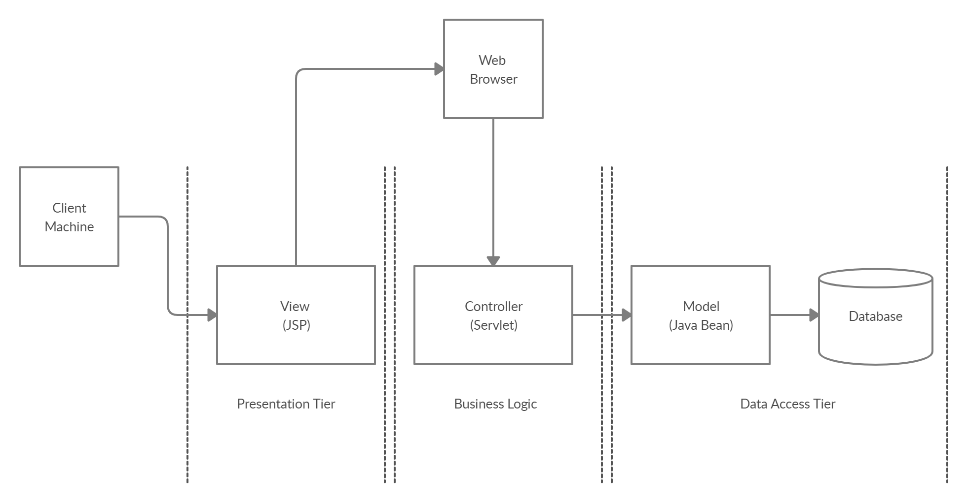
Application Architecture: (MVC)

Slide 9
Tools and Libraries:
Tools
NetBeans IDE
Xampp Server
UmLet
Dia Diagram Tool
Creately
Libraries
MySql Connector
Javamail API
SMTP & Mail API

Slide 10
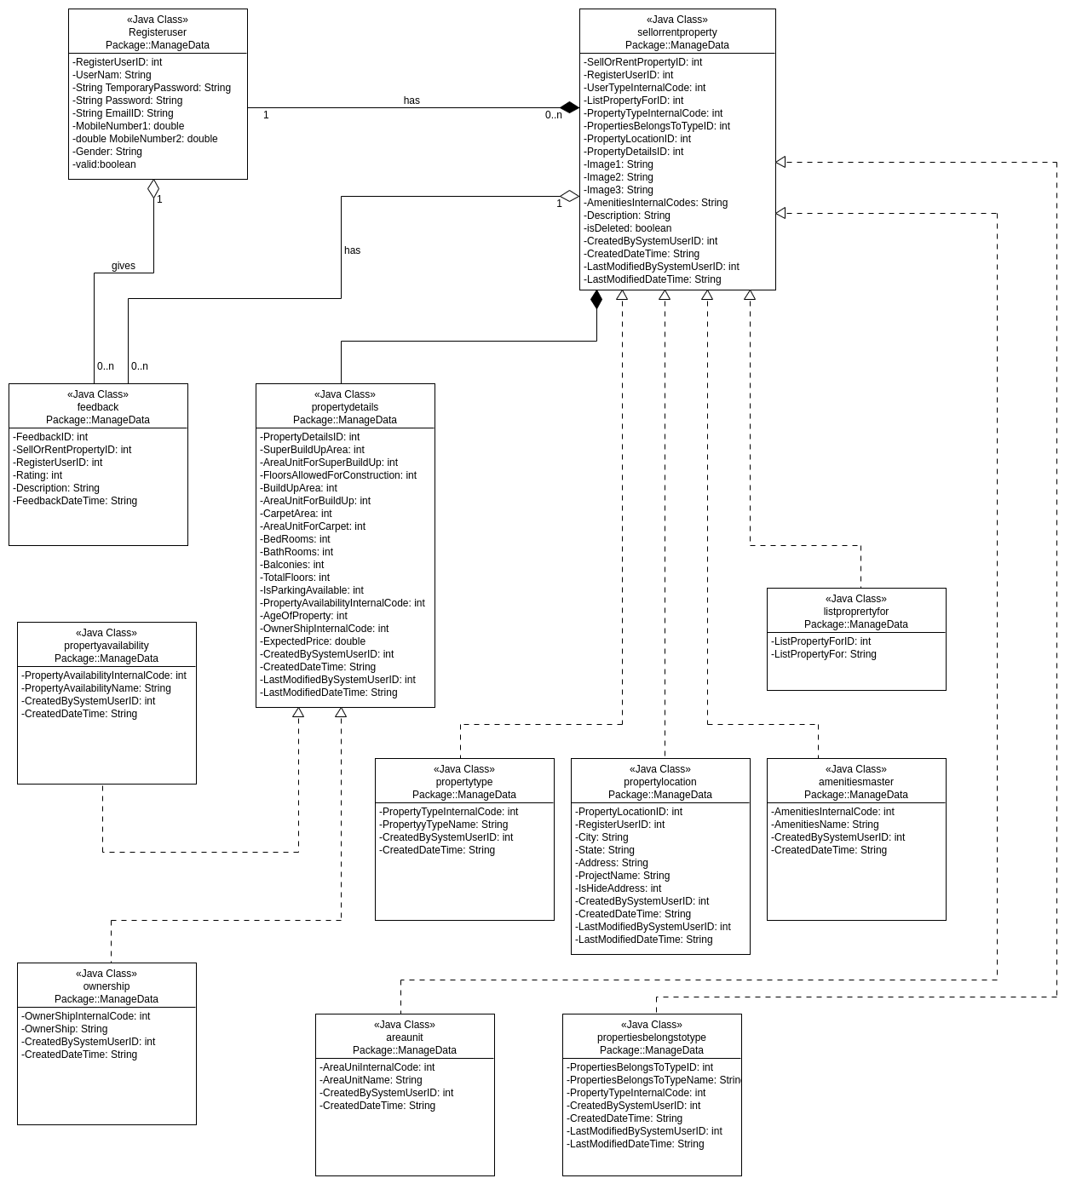
Detailed Class Diagram:

Slide 11
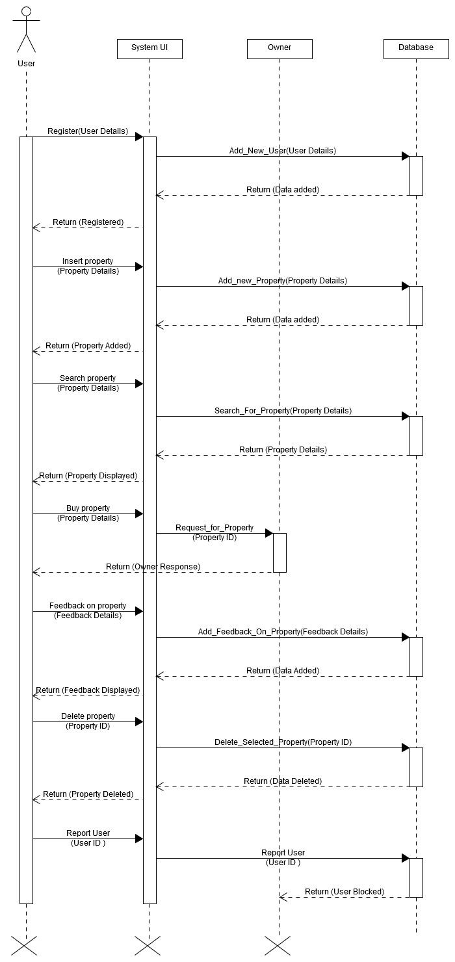
Sequence Diagram:

Slide 12
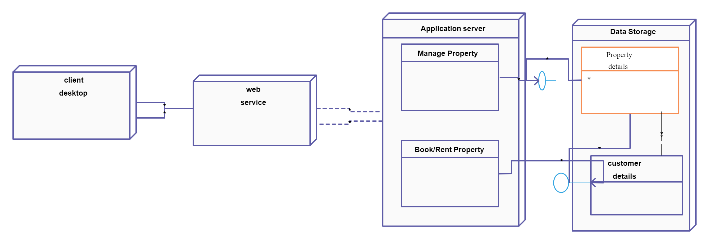
Deployment Diagram:

Slide 13
Individual Contribution of each member:
Name | Role
Mahima Gajiwala (201812062) Yash Mehta (201812085) Vivek Makwana (201812089) Soniya Vaidya (201812113) Denish Maniya (201812118) | Backend Development, Integration, Documentation Documentation, Backend Development Full stack Development, Testing, Documentation Documentation, Backend Development Full stack Development, Testing, Documentation

Slide 14
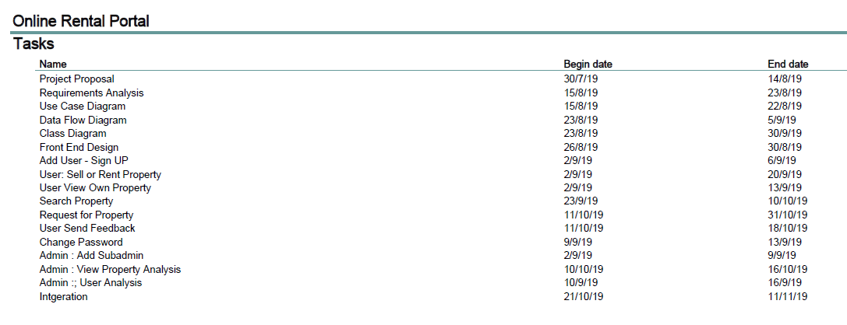
Gantt Chart:

Slide 15
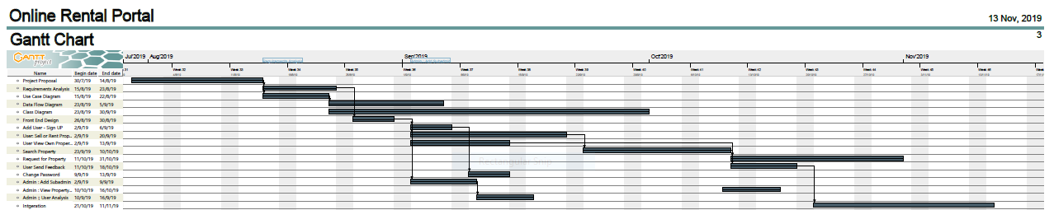
Gantt Chart:

Slide 16
Resources Chart:

